Slide 1

Context-Free Grammar (CFG) and Implementation Using ANTLR in IntelliJ IDEA
CSI 412: Compiler Laboratory(A)
Course Teacher:
Mir Moynuddin Ahmed Shibly
Lecturer, Department of CSE
United International University
Fajla Rabby Khan
ID: 011151145

Slide 2
Introduction
Context-Free Grammar : Context-Free Grammar (CFG) is a formal grammar that describes the syntactic structure of a language. It consists of a set of production rules that define how sentences in the language can be constructed. CFGs are widely used in the specification of programming languages and document structures.Key features:
Formal rules
Hierarchical structure
Generative power
.g4 grammars: A .g4 file is a notation used in the context of ANTLR (ANother Tool for Language Recognition), a powerful parser generator. The .g4 file contains a grammar specification written in the ANTLR's custom syntax. ANTLR is often used to generate parsers for various programming languages or domain-specific languages.
Grammar's purpose:
Language Specification
Parser Generation
Code Analysis
Compiler and Interpreter Construction
Language Transformation

Slide 3
Grammar Structure Overview
prog (root element)- The top-level element representing a complete program.
headerDeclaration- Includes external header files.
variableDeclaration- Declares variables with data types and optional initial values.
functionDeclaration- Defines functions with their return types, names, parameters, and bodies
controlFlowStatement-Control the flow of program execution.
ifElseStatement
forLoop
whileLoop
expressionStatement- Expressions followed by semicolons
functionCall- Invokes previously defined functions.
returnStatement-Returns values from functions.

Slide 4
Grammar Rules
headerDeclaration:
Purpose: Including external header files.
Syntax: #include<filename>
Example: #include<stdio.h>
variableDeclaration:
Purpose: Declaring variables with data types.
Syntax: dataType variableName (ASSIGN expression)? SEMICOLON
Example: int age = 25;
functionDeclaration:
Purpose: Defining functions with their components.
Syntax: dataType functionName LPAREN parameters? RPAREN compoundStatement
Example: int add(int a, int b) { return a + b; }

Slide 5
Grammar Rules
controlFlowStatements:
Purpose: Controlling program execution flow.
Include individual slides for:
ifElseStatement
forLoop
whileLoop
expressionStatement:
Purpose: Performing assignments or calculations.
Syntax: expression SEMICOLON
Example: x = y + 10;
functionCall:
Purpose: Invoking previously defined functions.
Syntax: functionName LPAREN functionParameters? RPAREN
Example: result = calculateArea(length, width);

Slide 6
Grammar Rules
returnStatement:
Purpose: Returning values from functions.
Syntax: return expression? SEMICOLON
Example: return answer

Slide 7
Data Types
int:
Represents whole numbers (integers).
Examples: 10, -5, 0
Usage: int age = 25;
float:
Represents single-precision floating-point numbers (decimals).
Examples: 3.14, -1.5e2, 0.0
Usage: float price = 19.99;
double:
Represents double-precision floating-point numbers (more decimal digits than float).
Examples: 1.23456789
Usage: double pi = 3.1415926535;
string:
Represents textual data (sequences of characters).
Examples: "Hello, world!", "This is a string.", "" (empty string)
Usage: string name = "John Doe";

Slide 8
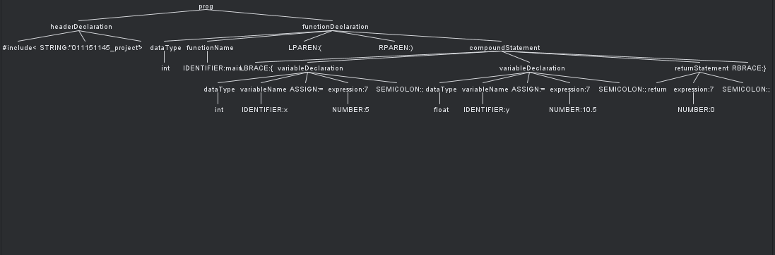
Examples
1.If-Else Statement:
#include<"011151145_project">
int main() {
int x = 5;
float y = 10.5;
return 0;
}

Slide 9
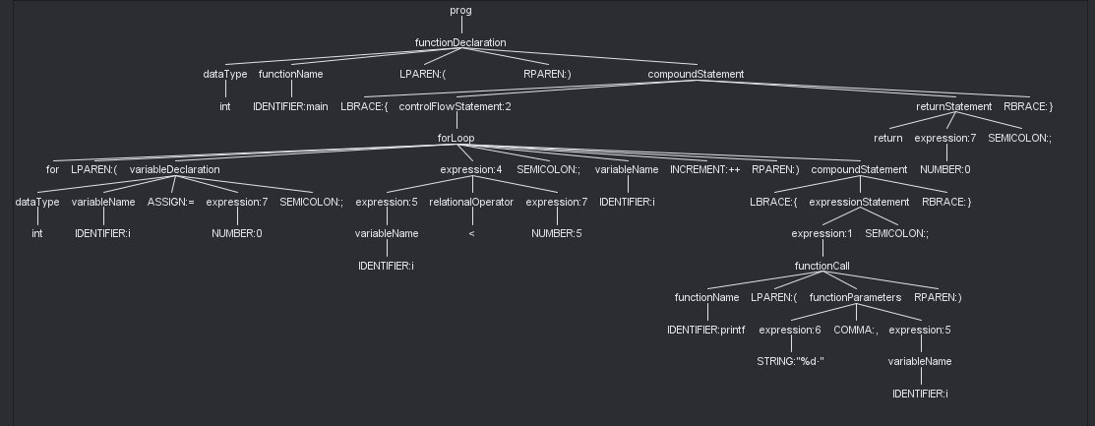
Examples
1.For Loop:
int main() {
for (int i = 0; i < 5; i++) {
printf("%d ", i);
}
return 0;
}
turn 0;
}

Slide 10
Conclusion
Key Takeaways:
We explored the grammar, its structure, and its rules for building programs.
We learned about its core components such as data types, expressions, control flow statements, and functions.
We saw how these elements work together to create logical and efficient programs.
Essential Grammar Rules:
Programs are formed using headers, variable declarations, function definitions, control flow statements, expressions, and function calls
Data types define the kind of information variables can hold (int, float, double, string).
Expressions combine values, variables, and operators to produce results.
Control flow statements like if-else, for loop, and while loop guide the program's execution.
Functions encapsulate code for modularity and reusable logic.

Slide 11


